Slide 1
Natural Gas Engine Oil Considerations
CHEVRON LUBRICANTS CAN HELP YOU
RUN BETTER LONGER

Slide 2
Introduction
The purpose of this deck is to provide ancillary information that can help in the sales process of industrial gas engine and compression opportunities by providing things to consider and information that is often necessary.

Slide 3
Gas Type and Methane Number
Natural gas is a colorless, odorless, and clean-burning fuel that is used in industrial gas engines and dual-fuel engines (natural gas and diesel) in gas gathering and power generation applications. Pipeline quality natural gas (the type typically used to heat homes, provide fuel for cars, trucks and industrial gas engines) typically contains greater than 90% methane. The remaining percentage making up the gas is a mixture of other types of hydrocarbon gases such as ethane, propane, butane as well as containing inert amounts of carbon dioxide, nitrogen and hydrogen sulfide.
Methane is traditionally burned in stoichiometric (complete burn) or lean-burn conditions. Energy efficiency is higher for lean-burn than for stoichiometric gas engines. All natural gas engines deliver lower particulate matter (PM) emissions than diesel engines of comparable horsepower.

Slide 4
Types of Natural Gas
In on-road transport vehicles, methane is mostly used in a compressed form, compressed natural gas (CNG) being the most common, as well as liquefied natural gas (LNG).
Biogas is produced by anaerobic decomposition of animal and plant material, manure, sewage sludge, organic waste, etc. Biogas contains approximately 35 to 65 percent methane.
Landfill gas contains approximately 40% to 60% percent methane and contains a considerable amount of contaminants, much the same as biogas. Landfill gas may also contain siloxanes, and compounds of chlorine and flourine derived from household and industrial wastes that can present challenges in engines burning the gas.

Slide 5
Types of Natural Gas
Engines burning biogas or landfill gas require engine oils that will protect the engine from corrosive acids formed from contaminants in the fuel. The base number (BN) of purpose-designed biogas and landfill engine oils are typically higher than gas engine oils for engines burning pipeline quality natural gas.
Well head gas is gas produced at the well head and may contain hydrogen sulfide (H₂S). Gas that contains a moderate amount of H₂S is often referred to as sour gas.

Slide 6
Brake Mean Effective Pressure (BMEP)
The output power of a gas engine is related to the speed of the engine and the BMEP during the power stroke.
BMEP is the mechanical efficiency expressed as engine output relative to engine displacement.
BMEP is the “average” cylinder pressure on the piston during the power stroke.
BMEP of stationary gas engines have increased resulting in an increased heat load on modern engines.

Slide 7
Brake Mean Effective Pressure (BMEP)
A high BMEP value results in:
An increase of air density
An increase of the power output of the engine
Improved efficiency
Lower capital costs in kilowatt hours ($/kW)
BMEP can be increased by raising the combustion cylinder air pressure through:
Turbocharging
Improving after-cooling
Reducing pressure losses

Slide 8
Consolidation of OEM’S Caterpillar Gas Engine Brands
Caterpillar Inc
Markets CAT, MAK, MWM and Perkins brands of gas engines
CAT
The Cat brand is the cornerstone of the Caterpillar brand portfolio
MAK
Typically used in medium speed marine applications.
Offers main propulsion engines from 1,020 kW to 16,000 kW.
MWM
MWM gas engines can operate on a wide range of gaseous fuels and have power outputs between 400 and 4,300 KW.
Perkins
A global supplier of gas and diesel engines in the 4-2000 kW/5-2800 hp range.
The largest portion of sales is into the European market.

Slide 9
GE Gas Engine Brands
GE
Markets Jenbacher and Waukesha brands of gas engines
Jenbacher
Jenbacher gas engines have a power range of 250 kW to 10 MW with fuel flexibility to run either on natural gas or a number of other gases.
More than 15,500 Jenbacher gas engines are operating in 100-plus countries.
Waukesha
Designs for both rich-burn and lean-burn.
Capable of operating on a wide range of fuels, from 400 to 2,350 BTU/sq.ft

Slide 10
GE Gas Engine Brands
GE
Owns Ajax
Two-stroke engine-compressors
Ajax engines are rated 22 to 845 hp (16 to 630 KW)
Owns Superior
Four-stroke cycle engines rated 400 to 2700 hp (300 to 2000 KW)

Slide 11
The Effects of Engine Load at De-rating from Caterpillar LEXE08320-00
At low load (less than 50% rated load), gas engines may not have enough cylinder pressure to maintain oil control in the cylinder.
This allows the oil to work its way past the rings into the combustion chambers, leading to increased ash deposits.
These deposits change the compression ratio, which can reduce the detonation margin. If the detonation margin is reduced sufficiently, detonation can occur. Detonation will decrease the life of the engine, damage components and lead to unplanned shutdowns or failures.
Caterpillar recommends not loading natural gas generator sets in any application below 50 percent of their rated load for any duration, and the ideal range for operation is at 70 percent load and above.

Slide 12
The Effects of Engine Load at De-rating from Caterpillar LEXE08320-00
Extended operation of gas generator sets at low loads can lead to deposit build-up on the valves, spark plugs, and behind the piston rings. In extreme cases deposits in the cylinder can develop, causing cylinder liner polishing.
Additionally, natural gas engines run rich at low loads to maintain combustion and ensure that the engine does not misfire.
A rich air-to-fuel ratio causes the engine to deviate from the expected emissions levels, potentially leading to non-compliance with required emissions regulations.
Also, a rich air-to-fuel ratio increases temperatures and can accelerate component wear.

Slide 13
The Effects of Engine Load at De-rating from Caterpillar LEXE08320-00
Low-load operation will have an impact on all after-treatment components, causing emissions targets to be missed and ultimately leading to engine shutdown.

Slide 14
Base Number (BN) and Total Base Number (TBN)
Base number (BN) and Total Base Number (TBN), both used interchangeably, is a test measure of the alkalinity of an engine oil, reflecting the quantity of base expressed in milligrams (mg) of potassium hydroxide per gram (mgKOH/g).
BN is used to reflect an engine oil’s alkaline reserve, which neutralizes acids generated in the combustion process when fuel is burned. These acids aggressively attack metal surfaces so it is very important to formulate engine oils with sufficient alkaline reserve to help prevent engine wear.
Many OEMs have established an in-service engine oil condemning limitation of 50% of new oil BN or (TBN), verified by oil analysis of the used engine oil using test method ASTM D2896. However, they do not always specify which test method to use for BN on used oil.

Slide 15
Base Number (BN) and Total Base Number (TBN)
ASTM D2896 – normally reported for new oil TBN. This method uses perchloric acid to neutralize the alkalinity in the oil and yields a higher number than the test method typically used for used oil analysis by the oil analysis labs.
ASTM D4739 - normally reported for used oil analysis TBN. This test method uses hydrochloric acid to neutralize the alkalinity in the oil and produces a number lower (approximately 0.5 to 1.0 for gas engine oils) than ASTM D2896.
Customers using natural gas engines that are following the OEM recommendations for condemning limits for BN/TBN may consider requesting from the oil lab to report BN using ASTM D2896 instead of the default ASTM D4739. The lower numbers produced by the ASTM D4739 test method on oil analysis reports may cause a false assumption that the engine oil has reached its useful life and may prematurely change the oil when it is not necessary to do so.

Slide 16
Base Number (BN) and Total Base Number (TBN)
A high starting BN does not necessarily predict the actual longevity of the alkaline reserve or the rate of depletion.
Many competitive engine oils advertise high BN numbers that are rapidly depleted.
Comparing two different oils having different BN numbers does not always tell the whole story.

Slide 17
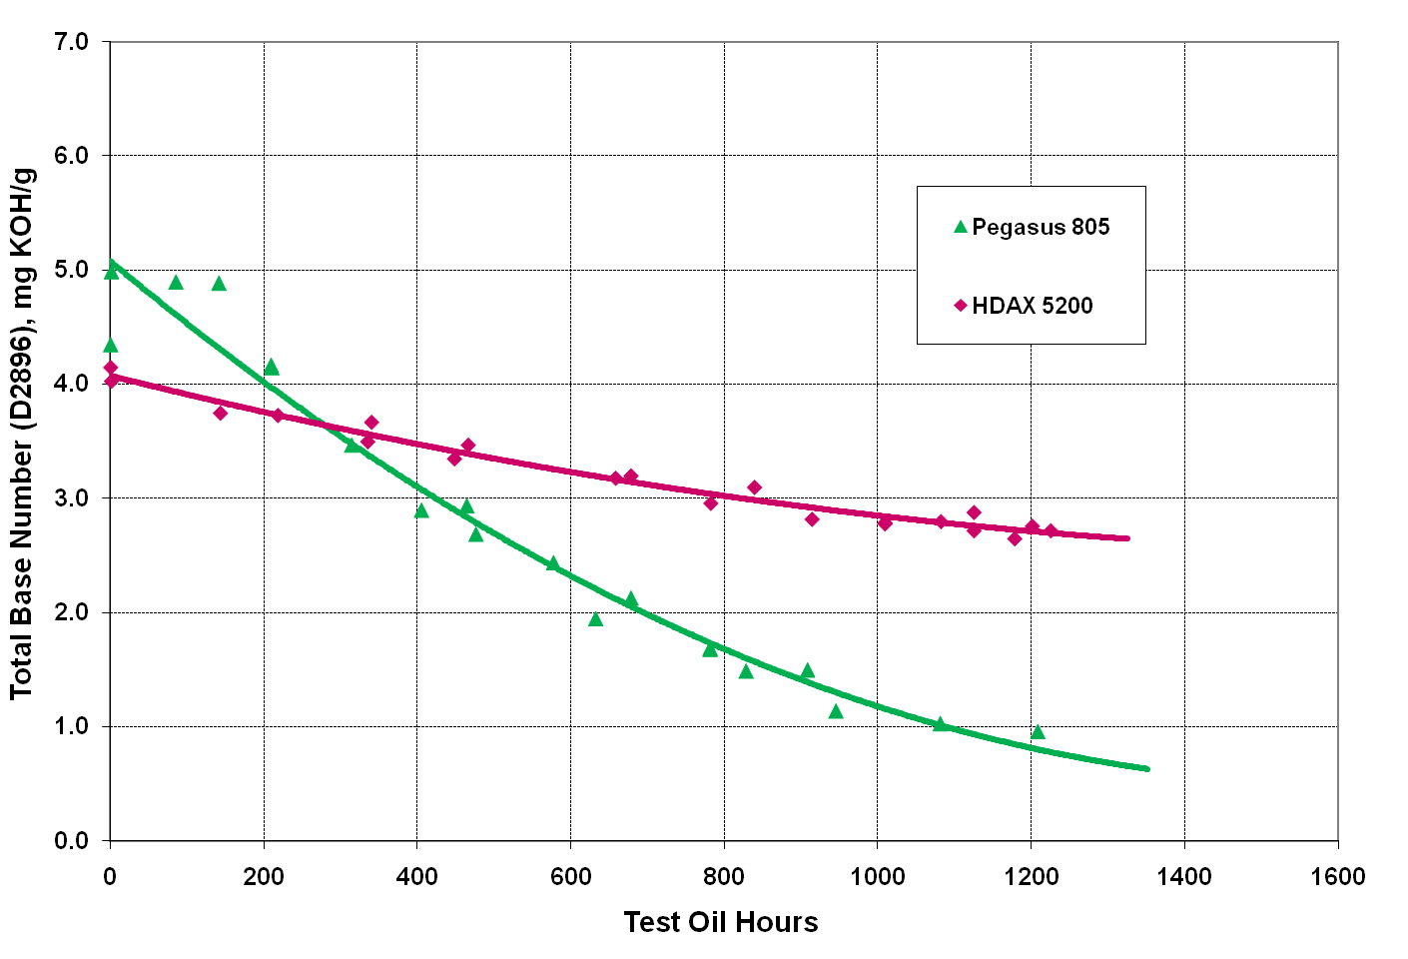
Used Oil Base Number Comparison Caterpillar 3516TA Field Test
Higher is better

Slide 18
Base Number (BN) and Total Base Number (TBN)
The alkaline reserve in an engine oil can be achieved using a combination of detergents, dispersants and anti-oxidants.
Detergents
Main Base Number component
Described as a “hard” base that allows the BN to deplete slower than dispersants
Controls deposits in the hot parts of the engine such as pistons
Direct neutralization of combustion
Dispersants
A weaker Base component described as a “soft” base
Allows the BN to deplete faster than detergents
Helps prevent engine deposits by suspending soot particles which can be acidic in nature

Slide 19
Base Number (BN) and Total Base Number (TBN)
Anti-Oxidants
The weakest Base component
Helps to reduce the rate of oxidation and viscosity increase
Contributes to a soft base
When using sour gas, wellhead or landfill gas, where the level of methane is below 80% and contains a higher level of sulfur and/or organic components such as carbon dioxide (CO2), hydrogen sulfide (H2S) and chlorine or fluorine, a greater concentration of alkaline reserve is needed.

Slide 20
Balanced Formulation is Key
An engine oil’s typical test data BN in the product’s specification can be increased using a soft dispersant additive
The soft dispersant is typically used up very quickly within the first 20 to 30% of operation
A competitive engine oil posting a higher BN than a comparable Chevron HDAX® oil may have much worse BN retention
Acid neutralization is an important factor to consider in an engine oil’s performance and engine oil drain extension capability

Slide 21
Balanced Formulation is Key
Some types of detergents do not neutralize weak acids effectively
They can appear to do a better job with Base Number retention
They may not fully neutralize all combustion acids
Wear can increase even though the BN looks sufficient in used oil analysis
The answer is a balanced formulation for optimized lubricant performance
Neutralize the acids formed – optimize base number retention
Disperse soot, reduce wear, oil oxidation, and minimize deposit formation

Slide 22
OEM Approval Field Testing
Field test durations often vary between 4,000 hours to 8,000 hours (approximately one year) in various types of engines.
The field test process is aligned with the field test guidelines of the OEM.
There are three phases:
Pre-test measurements
Activities during the test period
End of test inspection
The complete field testing process, including all of the roles and responsibilities between Chevron and the customers/owners of the gas engines are described in a written Field Test Agreement.
A written report is prepared detailing all phases of the test.
The test is initiated by installing new, pre-measured power assemblies (two).
During the field test used oil samples are taken and analyzed periodically to monitor oil condition, and operating data is collected.

Slide 23
OEM Approval Field Testing
Pre-test base line measurements are established compared to the OEM guidelines
Rings: measure and record end gaps.
Pistons: measure and record ring side clearances. Cylinder liners: measure and record the lateral and longitudinal diameter.
Valve recession: measure and record stem height of each valve.
A Borescope inspection of the test engine.
The engine oil is drained from the day tank, connecting pipe and test engine and flushed with test oil.
The oil filters are replaced.
The day tank is replenished with the test oil and the test is started.

Slide 24
OEM Approval Field Testing
Perform a borescope inspection at the midpoint of the test.
Measure for valve recession, if critical.
Provide any technical support to test site personnel as required regarding the lubricant under test and help them to assure proper control of test program.
Maintain records for engine load, emissions and oil consumption.
Intermediate inspections may be conducted to obtain an indication of performance at mid-test.

Slide 25
OEM Approval Field Testing
A final inspection is conducted at the end of the test to make a full assessment of wear and deposits:
General visual observation of engine condition, power assemblies and connecting rod bearings
Sludge, Lacquer and Carbon deposit rating
Dimensional measurements of valve recession, pistons, rings and liners
Photographs are taken to document conditions of critical parts.

Slide 26
End of Test Inspection
Perform borescopic inspection on all power assemblies of the test engine, and decide which units (typically 2) will be removed for full inspection.
Power assemblies for inspection may be predetermined by the units with new/measured parts in the pre-test
Perform dimensional measurements on the test assemblies.

Slide 27
End of Test Inspection
Determine sludge, lacquer and carbon deposits, by standardized rating of the parts and by photographing test assemblies.
Perform general observation for overall engine, power assembly and conrod bearing condition, leaks, damage, operational issues, scratches, wear patterns, unusual marks and unusual conditions.

Slide 28
End of Test Inspection Dimensional Measurements
Pistons (removed): with rings installed, measure ring side clearances, compare to OEM guidelines and record.
Rings (removed): measure gaps with rings placed in a cylinder diameter bore standard and record.
Cylinder liners (in engine): measure lateral and longitudinal diameters using a bore dial gage, properly calibrated by referencing to a bore diameter standard and record.
Valve recession: measure and record stem height of each valve using a measurement bridge with dial micrometer, compare to previous measurements and calculate recession wear rates, compare to OEM guidelines.

Slide 29
End of Test Inspection Deposit Rating
General engine condition
Overall condition
Non test power assemblies
Power assemblies
Piston crown
Rings
Lands
Grooves
Crankcase area
Top deck
Rocker assembly
Rocker cover
Crankcase covers
Crankcase interior

Slide 30
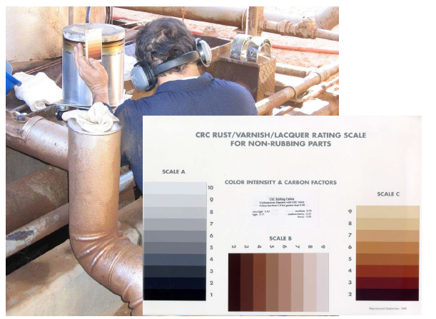
End of Test Inspection Rating of Lacquer and Carbon Deposits
Deposits are rated by comparing observed surface conditions with the appropriate CRC reference sheets.
Numerical demerits are calculated for each component and recorded.

Slide 31
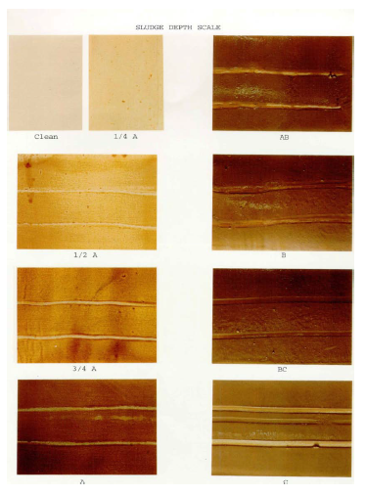
End of Test Inspection Rating of Sludge
Like deposits, sludge is rated by comparing visually observed surface indications with the CRC reference sheet.
A numerical value is assigned for each component and recorded.

Slide 32
Used Oil Analysis Schedule
Elements by Inductively Coupled Plasma-AES (ASTM D5185)
Kinematic Viscosity at 40°C and 100°C (ASTM D445)
Total Base Number (TBN) (ASTM D2896)
Total Acid Number (TAN) (ASTM D664)
Initial pH (ASTM D664)
Oxidation by FTIR (DIN 51453)
Nitration by FTIR (DIN 51453)
Water content by Karl Fischer (ASTM D6304)
Soot content by IR
Glycol content by IR
Pentane insolubles (ASTM D893)

Slide 33
Thank You.

