Slide 1

YOU’RE NOT
JUST BUYING LUBRICANTS
Optimal Drain Intervals
Controlled Maintenance Costs
Exceptional Performance
Minimal Downtime
Maximum Profitability
YOU’RE BUYING RELIABILITY
Compressor Oils: Proof of Performance
Cetus® HiPerSYN® / Cetus PAO

Slide 2
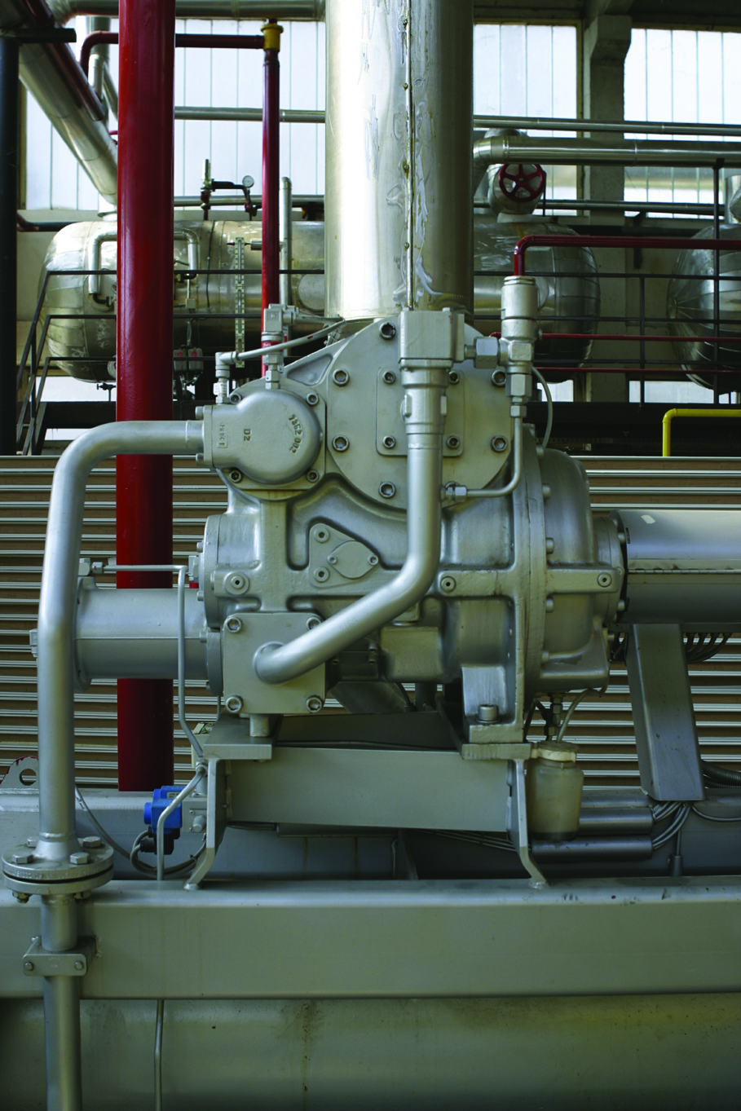
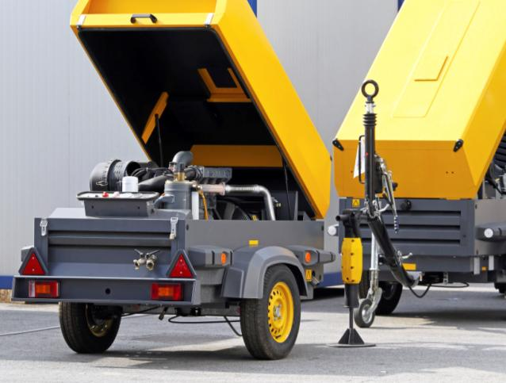
Compressor Equipment

Slide 3
Competitive Testing – Focus Areas
Oxidation Stability
  Long oil service life at high temperatures
    RPVOT test ASTM D2272
Anti-wear Protection
  Long service life of compressor components
    4-ball wear ASTM D4172
Seal Swell Compatibility
  Maintain seal integrity to prevent oil leakage
    Rubber swell test ASTM D471

Slide 4
ASTM Bench Testing Comparisons
Compressor oils tested in this program included (all ISO 46 grades):
  Cetus® HiPerSYN ® 46 Group III
  Cetus ® PAO 46 PAO
  Competitive PAO 46 PAO
  R&O 46 Group II
  R&O 46 Group I

Slide 5
RPVOT Test – ASTM D2272
The Rotary Pressure Vessel Oxidation Test is a rapid test used to determine the oxidation stability of an oil in the presences of water, oxygen and copper at 150°C. The results are reported in minutes.
Better
Oxidation Life in Minutes

Slide 6
Four-ball Wear Test – ASTM D4172
Determines the wear preventive performance of a compressor oil by measuring the wear scar in a four-ball sliding steel-on-steel application under 40kg load, at 1200 rpm, at 75°C for 1 hour.
Wear Scar Dia., mm
Better

Slide 7
Rubber Seal Swell Test – ASTM D471
The Elastomer Compatibility Test determines the effects of a lubricant on an elastomer in the presence of heat. The hardness change and percent volume change are reported. Buna N Nitrile (NBR) is used (168 hour, 100°C).
Volume Change %
Volume Change, % (positive) Seal Swell
Better
Shore A Durometer
Hardness Change
(negative) Softer
Shore A Hardness Change

Slide 8
New Cetus® HiPerSYN® and Cetus PAO Oils Show Excellent Performance Compared to Competitive PAO Synthetic oil
Excellent oxidation stability performing better in RPVOT than competitive PAO synthetic. Delivers value through:
  Increased equipment up-time
  Increased lubricant service life at high temperatures
  Less frequent oil changes reducing total lubrication maintenance tasks
Excellent overall anti-wear protection Delivers value through:
  Potential to provide long service life of compressor components
  Potential for increased equipment up-time and reduced total cost of ownership (TCO)

Slide 9
New Cetus® HiPerSYN® and Cetus PAO Oils Show Excellent Performance
Outstanding seal compatibility, Buna N Nitrile (NBR) with minimal hardness change and seal swell . Delivers value through:
  Reduced leaks/lubricant carry over
  Reduced potential for safety mishaps
  Improved service life of equipment

Slide 10
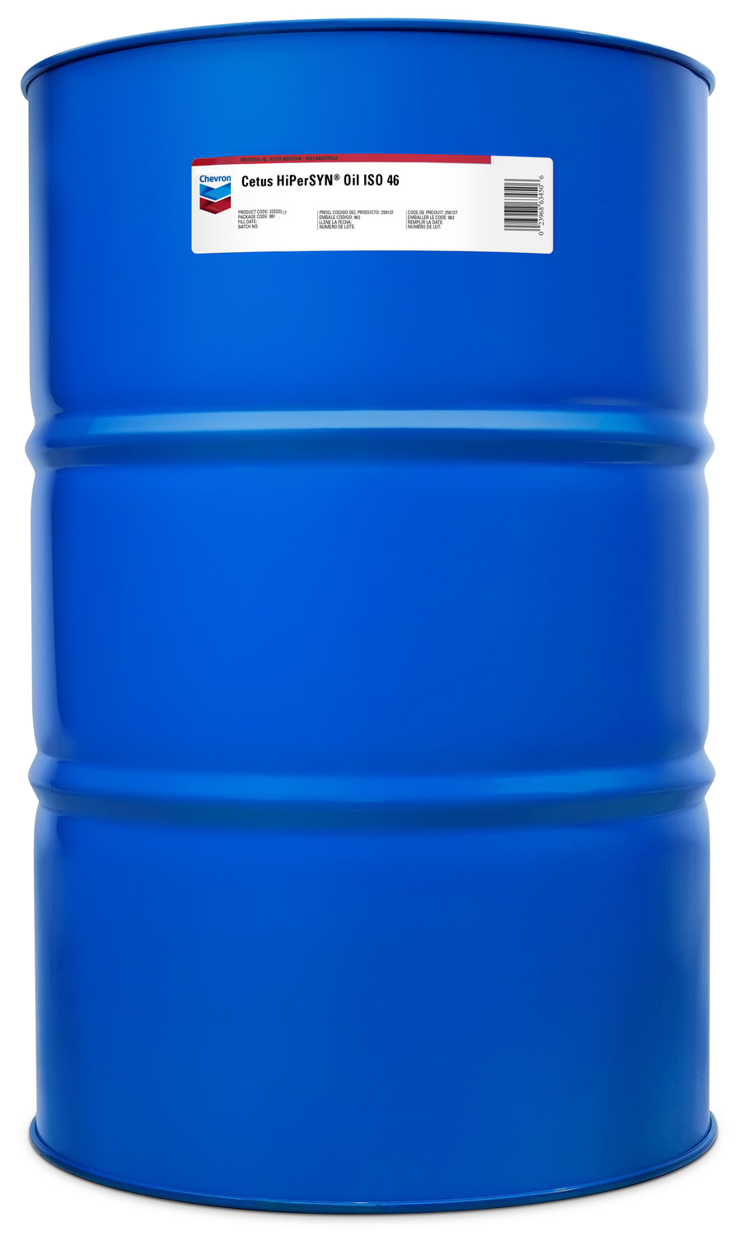
Comments
Where synthetic PAOs are specified or desired, Cetus® PAO is a viable option to replace competitive lubricants to capitalize on potential to improve lubricant life, component life and reduced total cost of ownership (TCO) as evidenced in the discussed ASTM tests.
Cetus® HiPerSYN, formulated with Group III
synthetic base oils, may offer an advantage to expensive PAO synthetics, without sacrificing advantage of improved lubricant life, component life or reduction in TCO, as evidenced in the discussed ASTM tests.

